Slide 1
A
B
Figure 1.

Slide 2
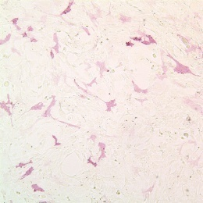
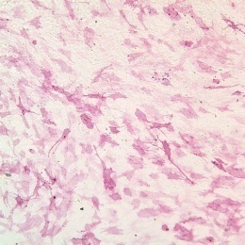
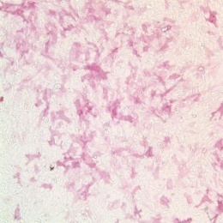
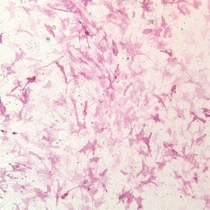
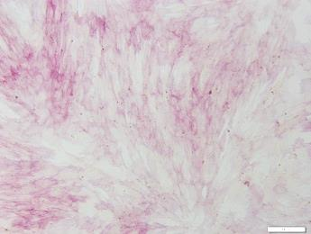
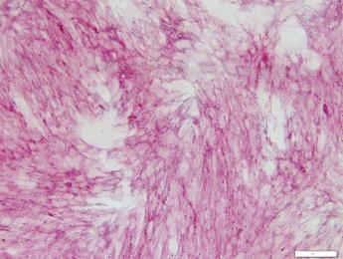
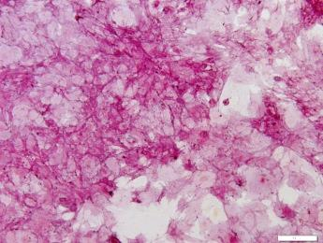
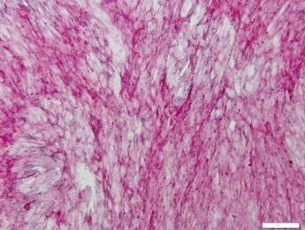
A
Control
Osteogenic media (OM)
Propofol (μM)
0
0
20
50
Day 4
Day 8
B
Control
N.S.
OM
OM + Propofol 5 μM
OM + Propofol 20 μM
ALP activity (nmol/well)
OM + Propofol 50 μM
Figure 2.

Slide 3






A
RT-PCR
Control
Osteogenic media (OM)
Propofol (μM)
0
0
20
50
ALP
OCN
OPN
RANKL
OPG
HPRT
B
Quantitative Rea ltime-PCR
*
*
Relative Exp./HPRT mRNA
Propofol (μM)
0
0
20
50
Control
Osteogenic media (OM)
Figure 3.

Slide 4
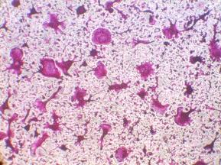
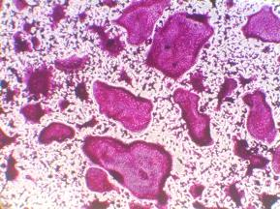
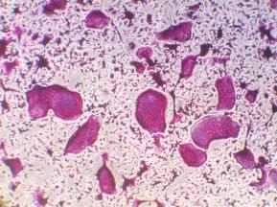
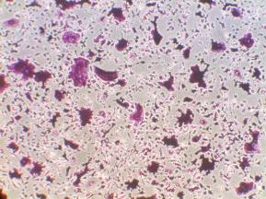
A
Conditioned medium (C.M.) preparation from osteoblasts
Media
change
Osteogenic media (OM)
with or without propofol
C.M.
Day 0
Day 7
Day 8
Osteoclast differentiation analyses
TRAP
staining
M-CSF & RANKL
C.M. treatment
(without M-CSF & RANKL)
Day 0
(BMM)
Day 1
Day 2
(pre-OC)
Day 3
Day 4
Day 5
(OC)
B
OM +
propofol 20 μM
OM +
propofol 50 μM
C.M.
Control
OM only
TRAP staining
(day 5)
*
OC number/well
Figure 4.

